Slide 1
EXPLORATORY DATA ANALYSIS

Slide 2
INTRODUCTION
NAME: VIVIAN KERUBO MOSOMI
Email: kerubomosmi7@gmail.com
Country: Kenya
College: Jomo Kenyatta University of Agriculture and Technology (JKUAT)
Specialization: Data Science

Slide 3
Problem Description
ABC Bank wants to predict whether a particular customer will buy their term deposit product based on their past interactions with the bank or other financial institutions. This will allow the bank to focus its marketing efforts on customers who are more likely to purchase the product.
GitHub Repository Link
https://github.com/Vee2002/DataGlacier_Internship/tree/vc/Data%20Glacier

Slide 4
1.UNIVARIATE ANALYSIS

Slide 5
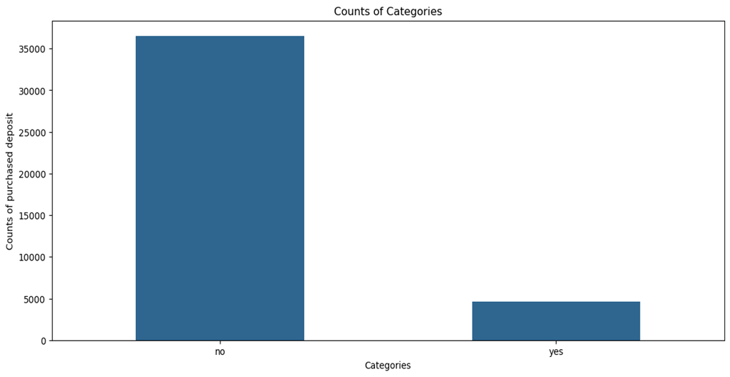
i) Purchased Deposit Counts
Most people did not purchase the term deposit

Slide 6
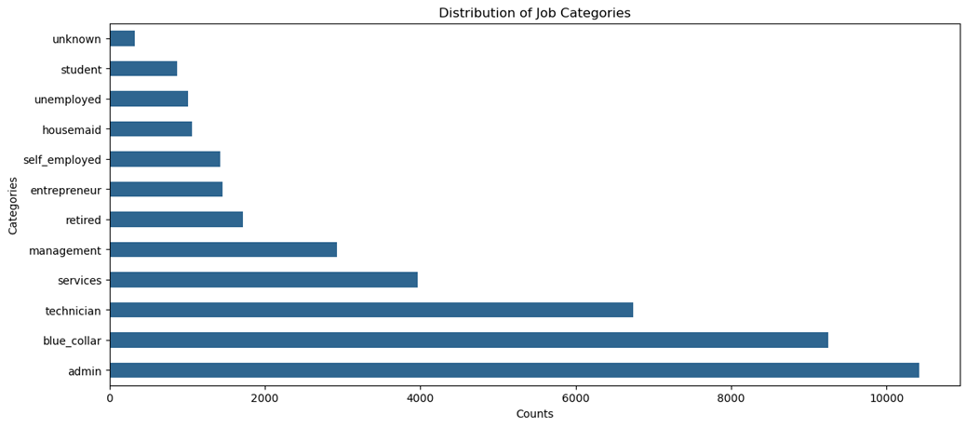
ii) Job Categories
Most people work as admins, followed by blue collar jobs and technicians.

Slide 7
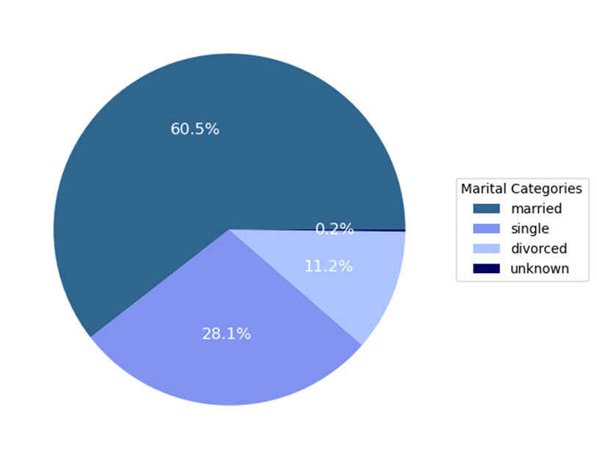
iii) Marital Categories
Most customers are married as they lead by 60.5%.Single people follow by 28.1%, and divorced are 11.2%.

Slide 8
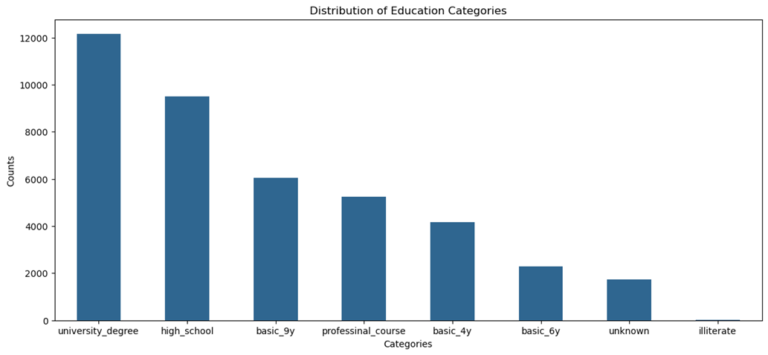
iv) Education Categories
Most people are at the level of university degree followed by high school.

Slide 9
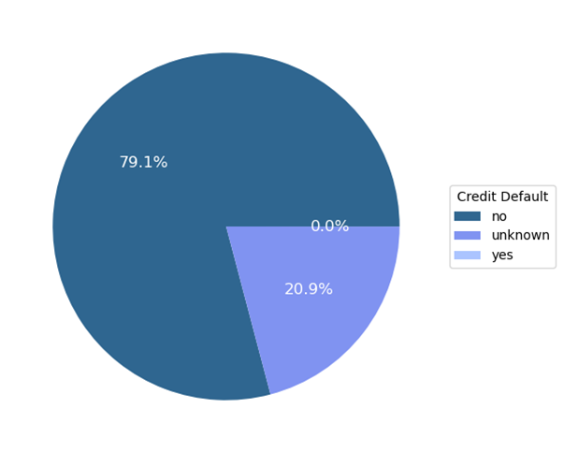
v) Default Loans
From the chart most people do not have credit defaults

Slide 10
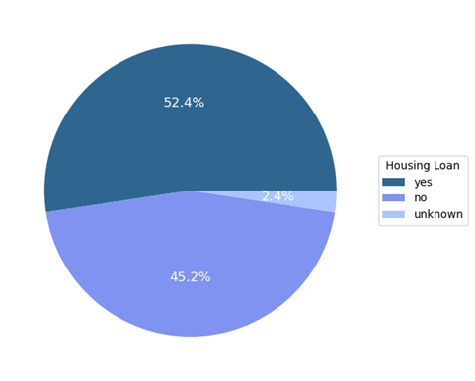
vi) Housing Loans
Most people have housing loans cause of the higher percentage of 52.4%

Slide 11
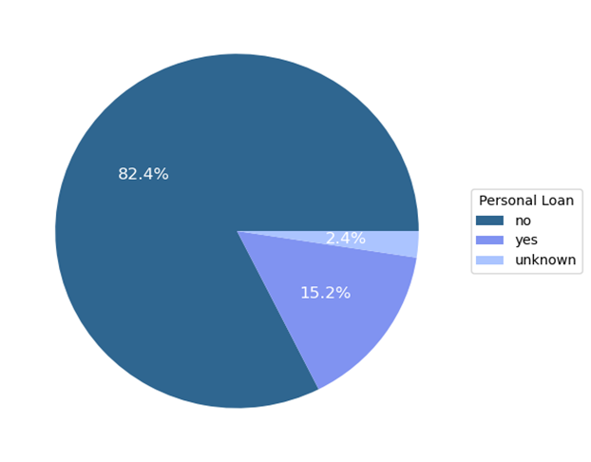
vii) Personal Loans
Most customers do not have personal loans

Slide 12
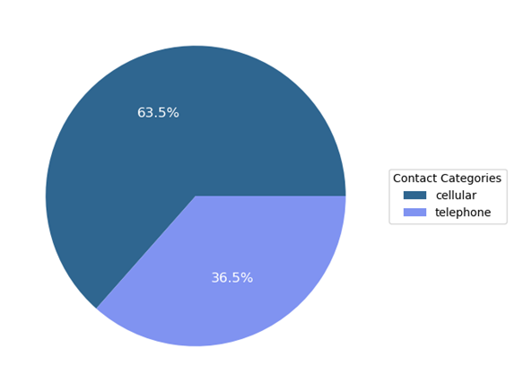
viii) Contact Categories
The contact is done to most customers via cellular not telephone.

Slide 13
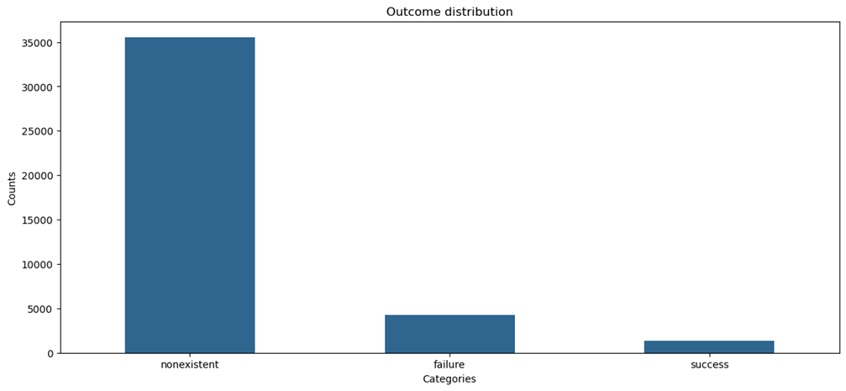
ix) Outcome of previous marketing campaigns
The above plot is communicating that most customers were not contacted during the previous marketing campaign and the failure was higher than the success.

Slide 14
2.BIVARIATE ANALYSIS

Slide 15
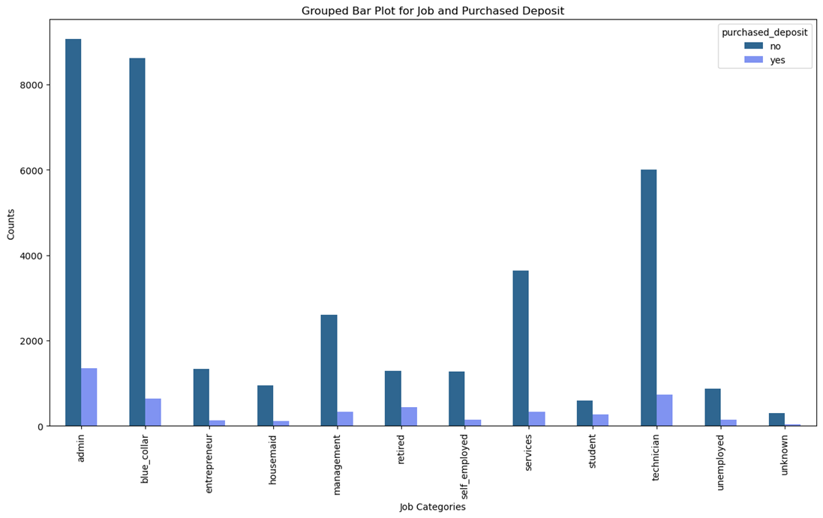
i) Job by purchased deposit
Most customers in their respective job categories did not purchase the term deposit.

Slide 16
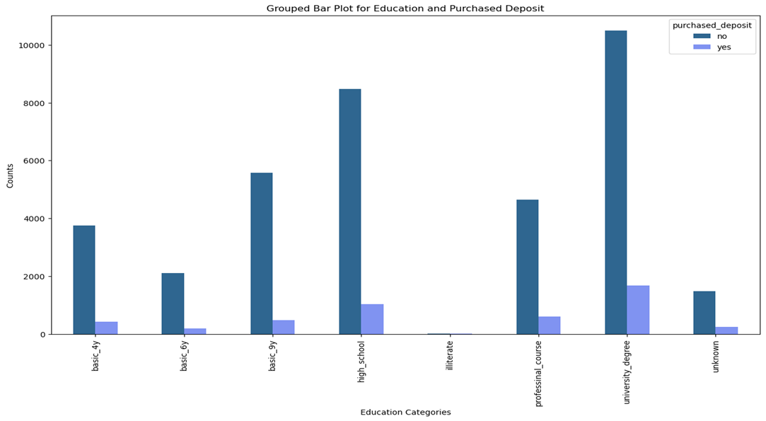
ii) Education by purchased deposit
The conclusion from the above plot is also that most people did not purchase the term deposit in all education levels. But those at the university degree level purchased more compared to others.

Slide 17
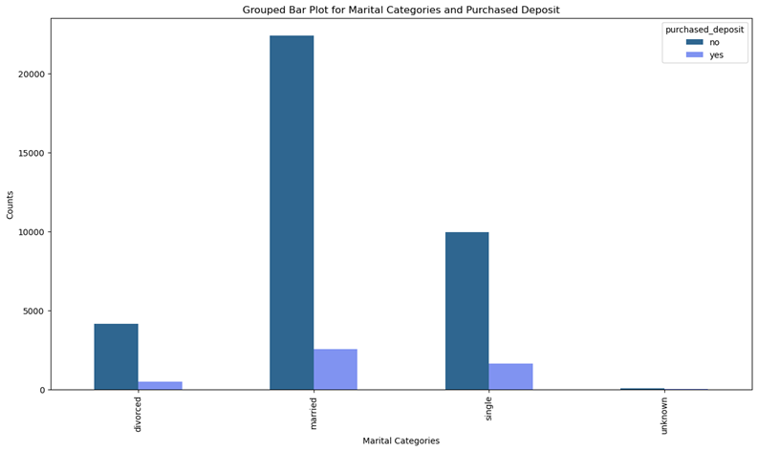
iii) Marital by purchased deposit
For marital categories, most customers also did not purchase the term deposit. But the leading group is the married one.

Slide 18
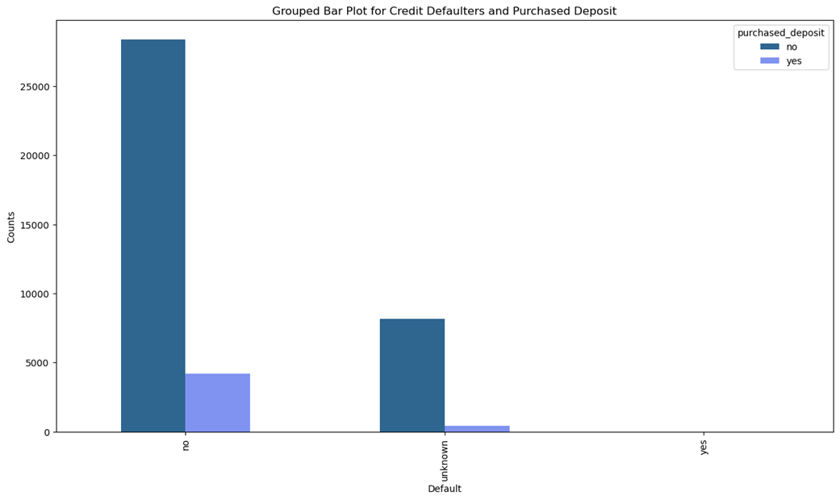
iv) Credit Defaulters by purchased deposit
Most people who do not have credit defaults did not purchase the term deposit.

Slide 19
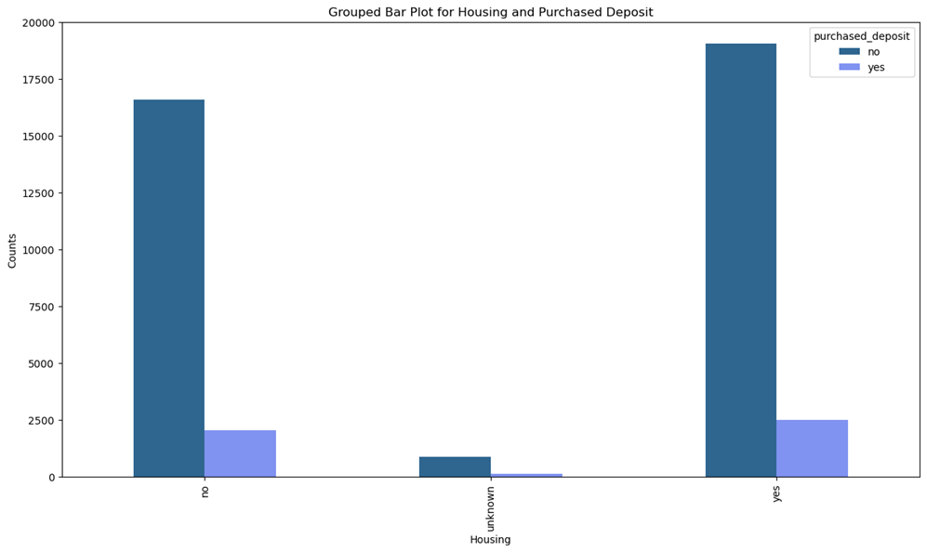
v) Housing by Purchased Deposit
People with housing loans purchase the term deposits more.

Slide 20
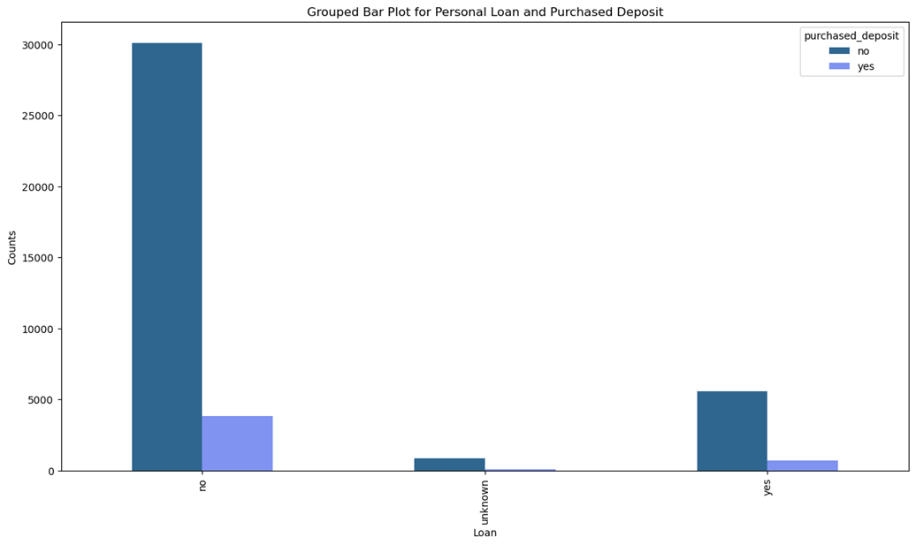
vi) Loan Default by purchased deposit
Most customers who do not have loans did not purchase the term deposit

Slide 21
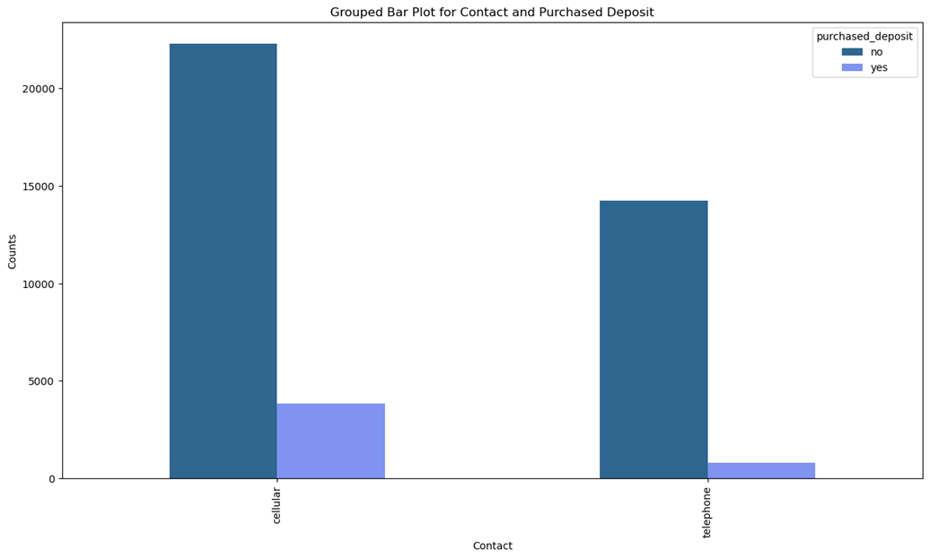
vii) Contact by purchased deposit
Most of the customers who were contacted by cellular and telephone did not purchase the term deposits but those who were contacted through cellular purchased the term deposit a bit more compared to those contacted through telephone

Slide 22
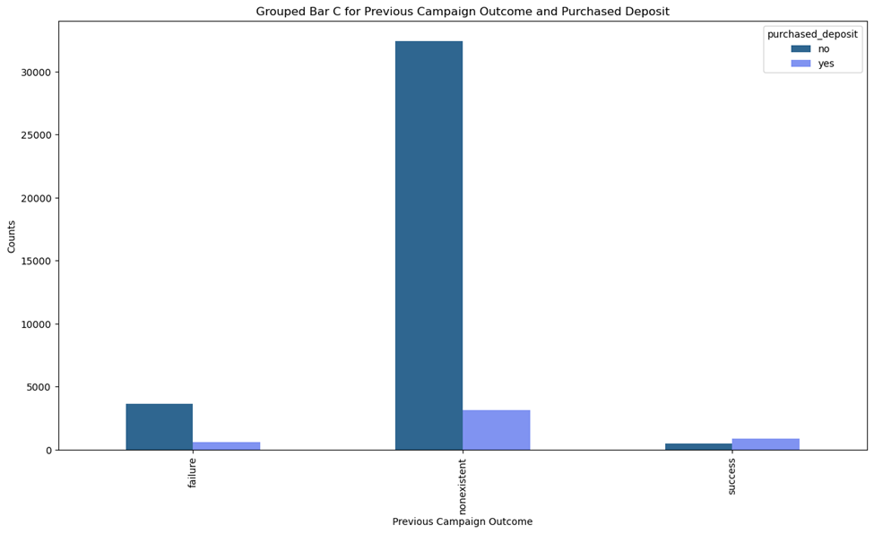
viii) Previous outcome of the campaign by purchased deposit
Many people were not contacted during the previous marketing campaign and hence not many people did not purchase the deposit

Slide 23
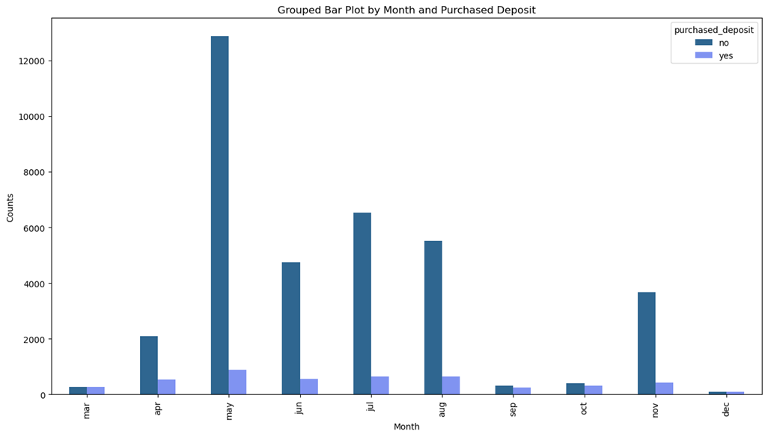
ix) Month by purchased deposit
Most customers did not purchase term deposits regardless of the month but the months May, June, July, August (Mid-Year), the purchase was better

Slide 24
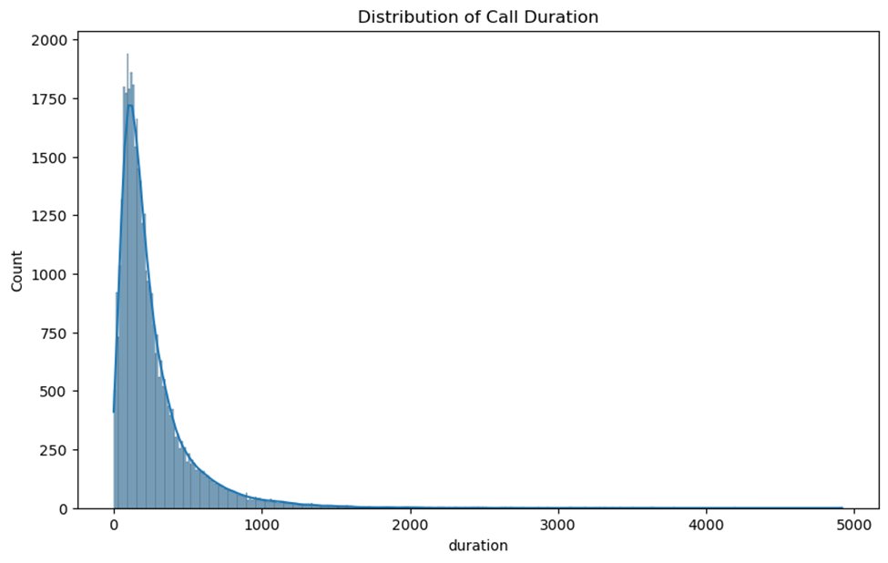
x) Distribution of call duration
Observation is that the duration for most calls to customers approximately ranges between 0 to 500 seconds.

Slide 25
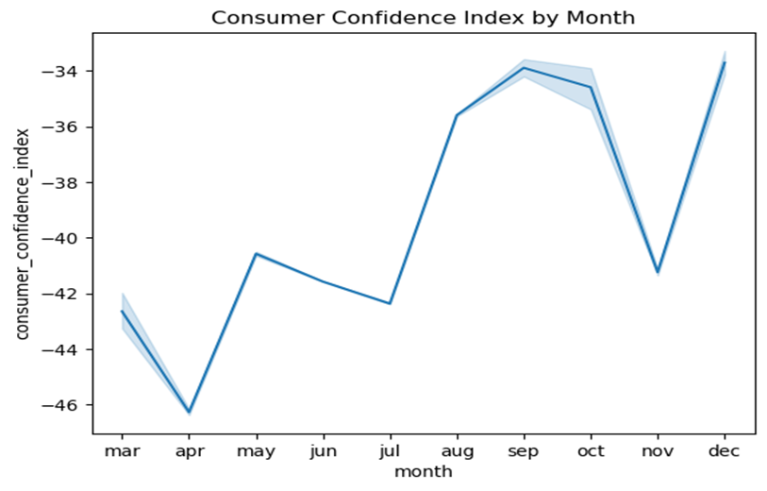
xiii) Consumer Confidence index by month
The plot shows a fluctuating trend on the consumer confidence index by months

Slide 26
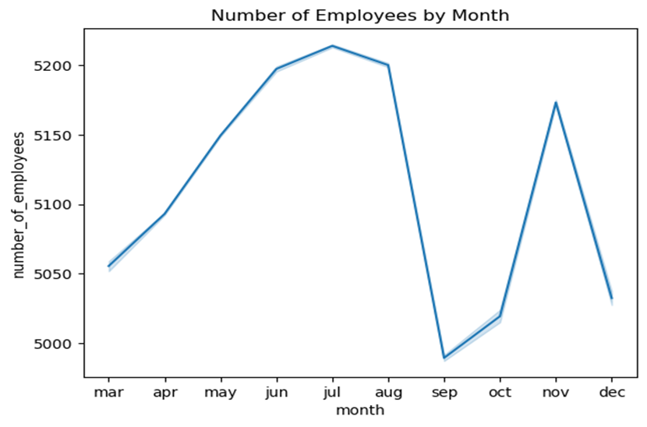
xiv) Number of Employees by Month
According to the plot, the number of employees is on the rise from March to August

Slide 27
3.UNIVARIATE ANALYSIS

Slide 28
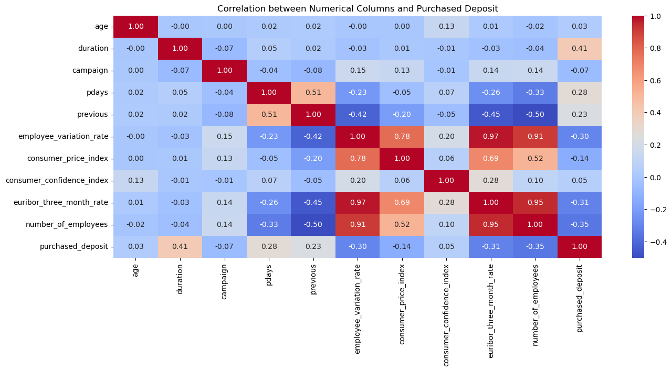
i) Correlation Plot
According to the plot, the number of employees is on the rise from March to August

Slide 29
Observations from the correlation plot
Duration is moderately positively correlated to purchased deposit. It has a positive correlation of 0.41
Pdays and previous are weakly positively related to purchased deposits. With a correlation of 0.28 and 0.23 respectively.
Age has a very weak positive correlation of 0.03 to purchased deposit.
The following columns are negatively correlated to purchased deposit:
campaign, employee_variation_rate, consumer_price_index, euribor_three_month_rate, number_of_employees.

Slide 30
4.RECOMMENDATIONS

Slide 31
1.Develop marketing campaigns that highlight the benefits of term deposits, such as security, returns, and suitability for long-term goals by promotions or incentives eg slightly higher interests for higher customers. The bank can consider holding webinars and workshops to educate customers on the importance of term deposits.
2.Increase the reach and frequency of marketing campaigns, particularly focusing on customers who were not contacted previously. By considering using cellular to contact customers as it is yielding more results compared to telephone.
3.Focus marketing efforts during periods of high consumer confidence or low inflation (e.g., early in the year or after mid-year). The bank can monitor economic indicators like the Consumer Confidence Index and Euribor rates to plan campaigns strategically.
4.Train agents to have meaningful, informative conversations that address customer concerns within the call duration 0-500 seconds as most calls are within that range. They can provide training to call agents on how to effectively pitch term deposits.

Slide 32
Recommended Models for this Dataset
The target variable for this dataset is purchased_deposit.That communicates whether the customer will purchase the deposit or not based on the independent variables.
Since the prediction is categorical,the following models can be used:
Logistic Regression
Decision Trees
Random Forest
Gradient Boosting Model eg XGBoost
Support Vector Machine

